Slide 1
Computer Graphics Procedural Solid Texturing
László Szécsi szecsi@iit.bme.hu
AIT

Slide 2
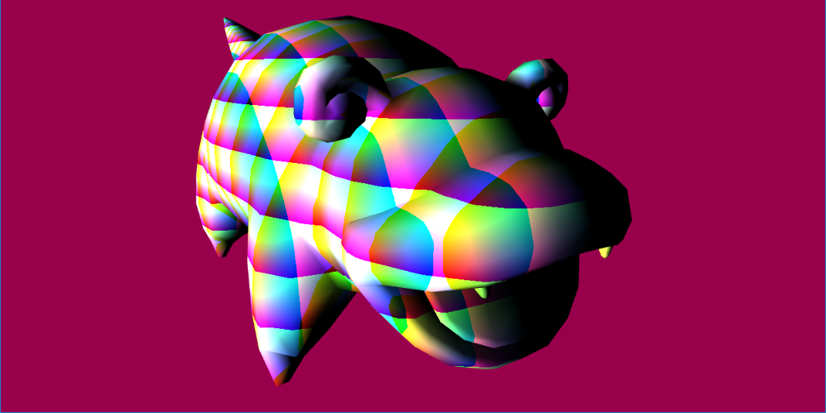
Procedural Solid Texturing
find color (or any optical material parameter) as a function of position, using a formula, not a texture
need model space position, to avoid the texture changing if the object moves
VS outputs modelPosition
yes, it is the same thing as vertexPosition
but an input and an output cannot have the same name
FS evaluates formula for modelPosition
e.g. fract(modelPosition) produces:

Slide 3
Wood – sawtooth stripes
float w = fract( modelPosition.x );
vec3 color = mix( material.lightWoodColor,
material.darkWoodColor,
w);
arbitrary constants or set as uniforms

Slide 4
Wood – tune frequency (stripe width)
float w = fract( modelPosition.x * material.freq );
vec3 color = mix( material.lightWoodColor,
material.darkWoodColor,
w);

Slide 5
Wood – perturb with noise
float w = fract( modelPosition.x * material.freq
+ pow(
snoise(modelPosition.xyz * material.noiseFreq),
material.noiseExp)
* material.noiseAmp
);
vec3 color = mix( material.lightWoodColor,
material.darkWoodColor, w);

Slide 6
Simple noise function
float snoise(vec3 r) {
vec3 s = vec3(7502, 22777, 4767);
float f = 0.0;
for(int i=0; i<16; i++) {
f += sin( dot(s - vec3(32768, 32768, 32768), r)
/ 65536.0);
s = mod(s, 32768.0) * 2.0 + floor(s / 32768.0);
}
return f / 32.0 + 0.5;
}

Slide 7
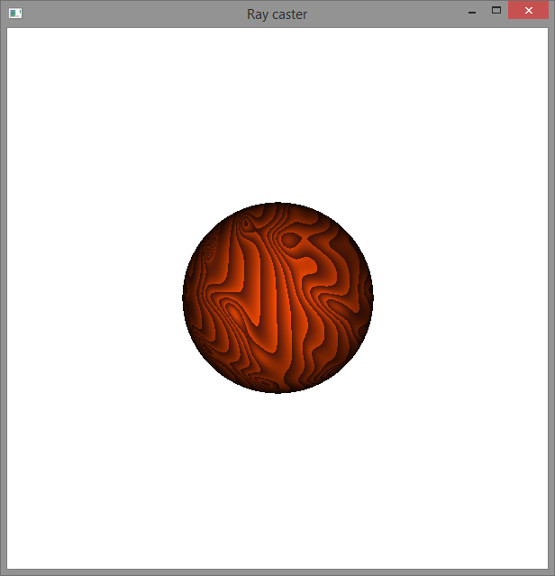
Tune parameters to make wood

Slide 8
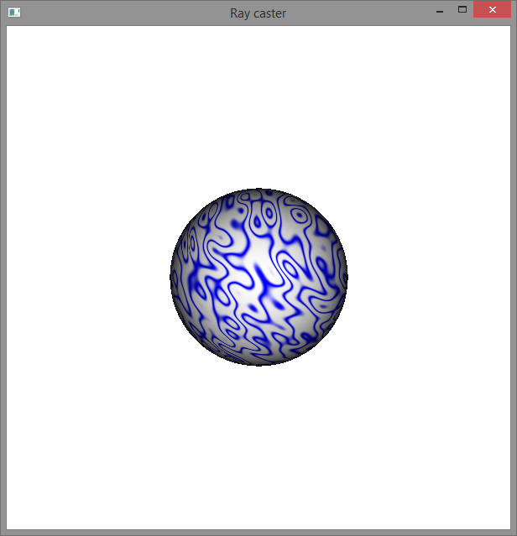
Marble
the same, but
sine wave instead of sawtooth
((sin(x)+1)/2)⁴ instead of fract(x)

Slide 9
Procedural Normal Mapping

Slide 10
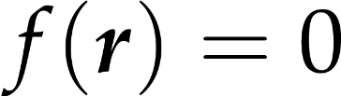
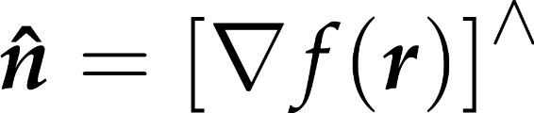
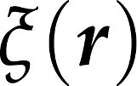
Procedural normal mapping
!
surface equation
surface normal formula
noise function
perturbed surface equation
thus: just add gradient-of-noise, evaluated at worldPosition.xyz, to original normal, then normalize
multiply noise gradient function input and output with appropriate factors to tune

Slide 11
Simple noise function and its gradient
float noise(vec3 r) {
uvec3 s = uvec3(
0x1D4E1D4E,
0x58F958F9,
0x129F129F);
float f = 0.0;
for(int i=0; i<16; i++) {
vec3 sf =
vec3(s & uvec3(0xFFFF))
/ 65536.0 - vec3(0.5, 0.5, 0.5);
f += sin(dot(sf, r));
s = s >> 1;
}
return f / 32.0 + 0.5;
}
vec3 noiseGrad(vec3 r) {
uvec3 s = uvec3(
0x1D4E1D4E,
0x58F958F9,
0x129F129F);
vec3 f = vec3(0, 0, 0);
for(int i=0; i<16; i++) {
vec3 sf =
vec3(s & uvec3(0xFFFF))
/ 65536.0 - vec3(0.5, 0.5, 0.5);
f += cos(dot(sf, r)) * sf;
s = s >> 1;
}
return f;
}

